Slide 1



AI Credit Risk & Loan Assessment System
PROJECT TEAM MEMBER
PROJECT TEAM MEMBER
Nimalan M
Nitin Aakash R K

Slide 2









Problem Statement
Rigid Linear Scoring
Financial Exclusion
Traditional FICO models fail to evaluate complex non-linear correlations across modern digital financial footprints.
Rejects "thin-file" applicants who lack conventional credit history despite possessing strong debt-repayment capacity.
High Latency
Opacity & Bias
Manual underwriting creates multi-day processing bottlenecks, driving up operational overhead and loan rejection friction.
Legacy rule scorecards lack explainability, introducing subjective human bias and regulatory compliance hurdles.

Slide 3
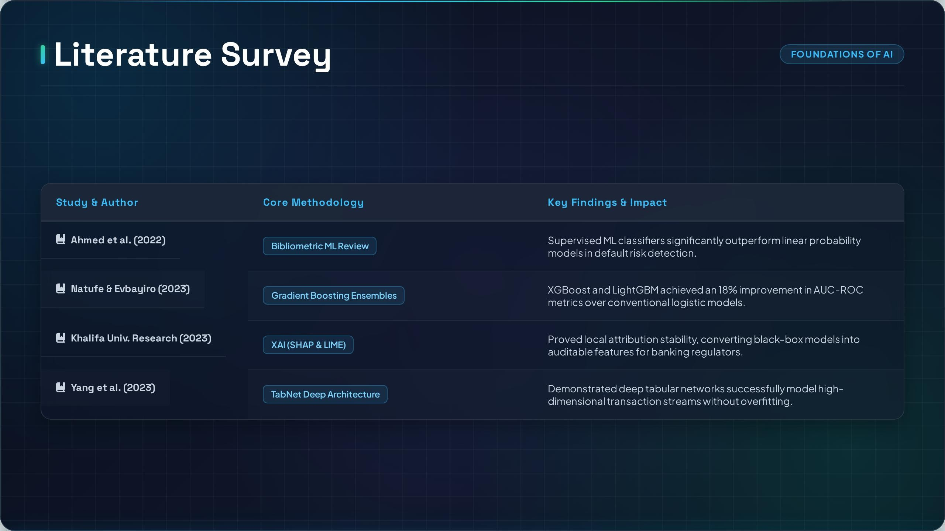

Slide 4


Existing vs. Proposed System
Existing System
Proposed AI System
Data Ingestion Static Bureau Reports
Data Ingestion Multi-Source Alt-Data Streams
Algorithm Logistic Regression / Rules
Algorithm XGBoost + TabNet Neural Nets
Decision Latency 3 - 7 Business Days
Decision Latency Real-Time Risk Scoring (< 2s)
Explainability Manual / Low Transparency
Explainability SHAP & LIME Feature Attribution
Borrower Coverage Restricted to Bureau Records
Borrower Coverage Inclusive Thin-File Assessment

Slide 5






System Architecture
Data Pipeline
AI Model Engine
XAI Framework
Decision API
Ingests transaction records & alt-data with automated missing-value imputation and feature scaling.
Trains ensemble models (XGBoost, LightGBM) to compute default risk probabilities.
Applies SHAP & LIME to quantify local feature contributions for total decision transparency.
RESTful API serving risk tiers (Low, Medium, High) directly to underwriter dashboards.
PROBABILITY FORMULATION:

